Slide 1

AI Platform for INFN Research Repository and Scientific Use Cases
Mauro Gattari (RM) – DSI/DataCloud
Marica Antonacci (BA) – DataCloud (FAIRS6, ICSCS0)
Luca Giommi (CNAF) – DataCloud (Terabit)
Gioacchino Vino (BA) – DataCloud
Consiglio Direttivo 11/2023

Slide 2
Agenda
INFN Scientific Repository
AI Platform for Scientific Use Cases
MLaaS for HEP, PNRR FAIRS6
What's Next

Slide 3
INFN
Scientific
Repository
Context:
  Open-access repository to collect research related digital artifacts: papers, thesis, talks – shared project among DSI, GLV and INFN GLOS
  Development of a system to collect metadata and metrics for the evaluation of INFN scientific productivity
  Technological upgrade of the existing INFN research DB operating since 2000
ML Use Cases:
  Match INFN projects / publications (Beta)
  Authors recognition (Alpha)
  Match VOR/AAM (R&D)

Slide 4
ML Use Cases
Semantic Search
  Find the INFN project that "best" matches a publication abstract:
  "...we compute the gravitational signal emitted when a white dwarf moves around a black hole…" -> CSN4/Teongrav
  "...the experimental observation of a strongly interacting gas of ultracold two-electron fermions with..." -> CSN2/Fish
Text Classification
  Recognize INFN structure name from author's affiliation string:
  "Frascati INFN, Ist Nazl Fis Nucl, Frascati, Italy" -> LNF
  "CSDC, Sez INFN Firenze, Florence, Italy" -> FI
Training on data extracted from INFN publications.

Slide 5
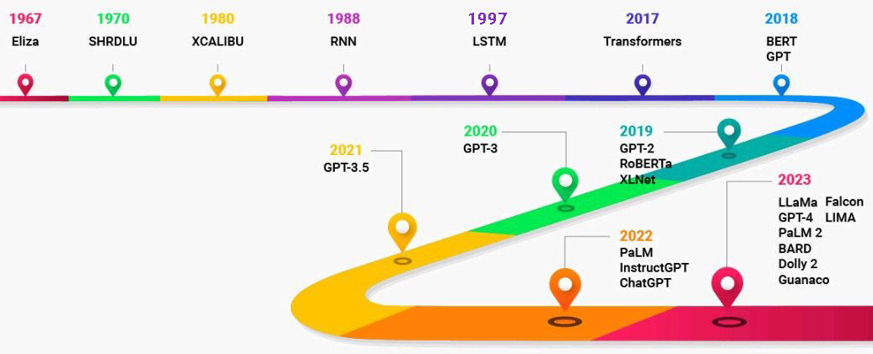
NLP/Transformers
NLP (Natural Language Processing): subfield of linguistics and computer science, primarily concerned with giving computers the ability to "understand" human language
A key event in the history of Language Models is the introduction of the Transformer architecture in 2017 (Google Brain team)
Transformer models outperformed existing solutions in solving NLP problems:
  ChatGPT => Generative Pretrained Transformer

Slide 6
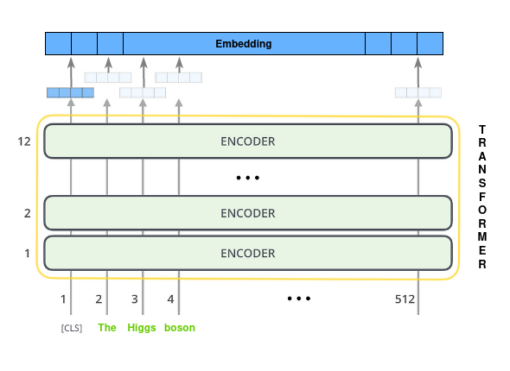
Transformer
Architecture
Transformer: transforms an input text into a mathematical object, named embedding
An embedding is a n-dimensional dense vector that that mathematically represents the semantics meaning of the input text
If properly trained, close vectors in the n-dimension space corresponds to semantically similar texts

Slide 7
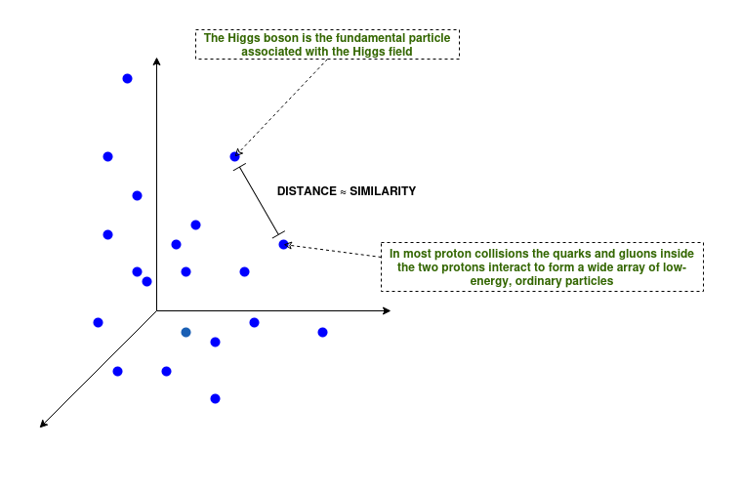
Use Case
Match INFN projects / publications
Training of Transformer model on domain language:
  60K INFN publication abstracts
  3 days training (Nvidia Tesla T4)
Build of the n-dimensional space of the Transformer embeddings: close vectors correspond to semantically similar texts
Semantic/geometric search in the vector space to classify new INFN publications

Slide 8
Semantic Search
Training Time / Accuracy
Model | Nr. Hidden Layers | Nr. Parameters | Training Time (10 epochs – 16M tokens) | Accuracy | Max Input Length
BERT | 12 | 109M | 8:24:03 | 71% | 512
BERT Large | 24 | 335M | 1 day, 2:20:31 | 75% | 512
LONGFormer | 12 | 148M | 1 day, 1:43:29 | 74% | 4096
LONGFormer Large | 24 | 434M | 3 days, 7:26:04 | 78% | 4096

Slide 9
Use Case
Predict INFN structure from author's affiliation
  Training of Transformer model on author's affiliation strings:
      ~6k positive samples
      ~6k negative samples
      dataset augmented to ~400k samples by adding "smart" typos
      6 hours training (Nvidia Tesla T4)
      95% accuracy on test set
Author's affiliation | INFN Structure
Catania Univ, Ist Nazl Fis Nucl, Lab Naz Sud, Catania, Italy​ | CT​
Bari INFN, Via E Orabona 4, I-70125 Bari, Italy​ | BA​
Dell INFN Frascati, Lab Nazl, Frascati, Italy​ | LNF​
INAF IASF Milano, I-20133 Milan, Italy​ | [NoSite]​

Slide 10
AI Platform
Application/Experiment agnostic
Train/fine-tune machine learning models at scale
Host/share datasets and trained models in the cloud
Serve models to make predictions about new data
Manage models and versions through a public INFN catalog
Provide a Web Application with a proper UI/UX that hides to the end-user the complexity of the platform
AI Platform
providing
Services in the Cloud

Slide 11
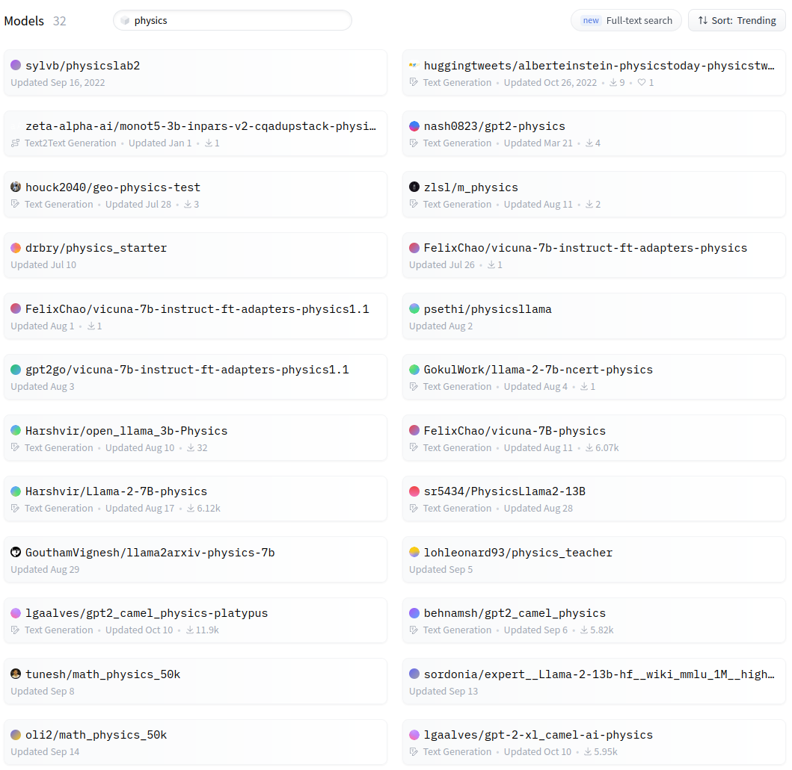
Web App
Example Model Catalog

Slide 12
AI Platform
Building Blocks - Technologies
Computing resources: CPUs, RAM, GPUs + Networking – INFN Cloud
Container Orchestrator: automate deployment, scaling, and management of workloads on physical/virtual nodes – Kubernetes
Event Source: decouple jobs submissions from their execution - Kafka
Orchestrator:
  Train: run distributed training jobs, hyperparameters tuning – Kubeflow Training Operator, Kueue, Katlib
  Inference: models serving – KServe, Knative + KPA, Batching, Deployment Strategies, Inference Pipelines
  Cluster Scaling - K8s AutoScaler, INFN Cloud Orchestrator/IM
NoSQL DB: keep jobs status; maintain public catalogs - Mongo DB
Object Storage: host data and models – S3, MinIO, Longhorn
Client Apps/Tools: Web App, CLI, SDKs, etc. to accelerate integration with the platform
on top of
INFN Cloud

Slide 13
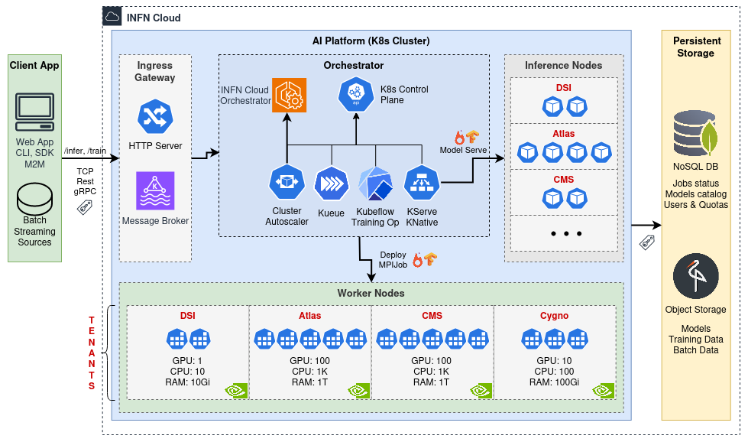
AI Platform
High Level Architecture
The AI Platform is being designed in collaboration with INFN Cloud whose core mission is to facilitate resource sharing and enhance accessibility for INFN users, encompassing a wide range of resources, including GPUs and storage.

Slide 14
AI Platform
High Level Architecture
The AI Platform is under active design/development:
technologies have been tested singularly;
lacks the glue (orchestrator, web app) among the several components.

Slide 15
AI Platform applications:
HEP-agnostic MLaaS
ML techniques in the HEP domain are ubiquitous, successfully used in many areas, and are playing a significant role in LHC Run 3 and in the future High-Luminosity LHC upgrade.
It would be useful a service that ease the adoption of ML in HEP analysis:
  existing HEP R&D solutions don't cover the whole ML pipeline, or they are not "aaS" solutions, or they are difficult to generalize to other use cases.
  existing MLaaS solutions cover many use cases but they are not directly applicable in HEP (e.g. lack of support for native HEP data, jagged array events, etc.).
The AI Platform is being designed to offer a service that is experiment-agnostic.

Slide 16
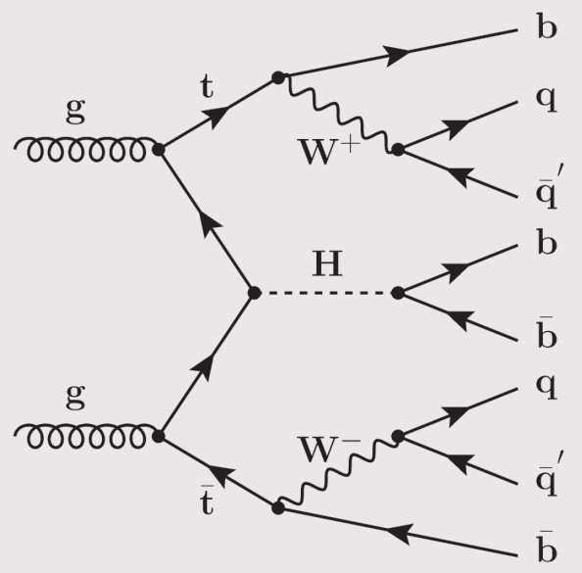
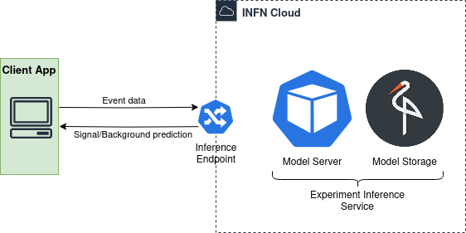
Real Case Scenario 𝑡𝑡𝐻(𝑏𝑏) analysis in the boosted, all-hadronic final states
Successfully deployed a ML model trained for signal vs background discrimination in a 𝑡𝑡𝐻 analysis in the boosted, all-hadronic final states problem
Inference service exposed through a INFN Cloud HTTP endpoint

Slide 17
AI Platform applications:
PNRR FAIRS6
FAIR Spoke6 - INFN leads WP6.7 Infrastructure and large scale solutions (BA, GE, PI, NA)
The activities "will focus on scientific use cases from hard science, and in particular Big-Data latest generation experiments which are nearing the Exabyte scale of treated data. It will design, implement and test ML solutions for the handling of such use cases, starting from ML/DL solutions specifically tailored to be executed on a distributed and loosely-connected data and processing sources, to a specific infrastructure-level solution also based on the existing and future infrastructures available (Bari ReCaS, the future National Centre on “Big Data, HPC, and Quantum Computing”, the INFN data center federation) and on existing curated datasets from the scientific experiments. The goal is to perform end-to-end tests on real scientific use cases, demonstrating the capability to design ML systems that are able to tackle extreme use cases from basic science, including requirements on timing during inference (for example in selection systems) and training time/resources."
Selected use cases:
  Multi-charm reconstruction with Machine Learning in ALICE at the LHC
  AI-supported algorithms in streaming readout (SRO) for HEP data acquisition systems
  Development of applications based on Graph Neural Network methods, for “Anomaly Detection” in HEP events within the ATLAS experiment at the LHC

Slide 18

Democratizing AI
Share data, algorithms, computing resources, and knowledge
Provide tools to automate and accelerate the lifecycle of an AI project
Reduce time and cost of AI development, increase productivity
Promote collaboration and openness, foster creativity
Promote widespread adoption of AI

Slide 19

What's Next
Project Finalization
Finalize platform architecture and technologies, promote adoption
Provide a Web Application to enhance accessibility for INFN users
Submit abstract to ISGC (International Symposium on Grids & Clouds) 2024
NLP
Improve use cases for INFN Scientific Repository
  consider smaller/larger language models
  collect more data for training
ML
Integrate ML scientific use cases to accelerate ML adoption in INFN research and activities, e.g. ML for HEP, FAIRS6, etc.

Slide 20
Thank You

