Slide 1
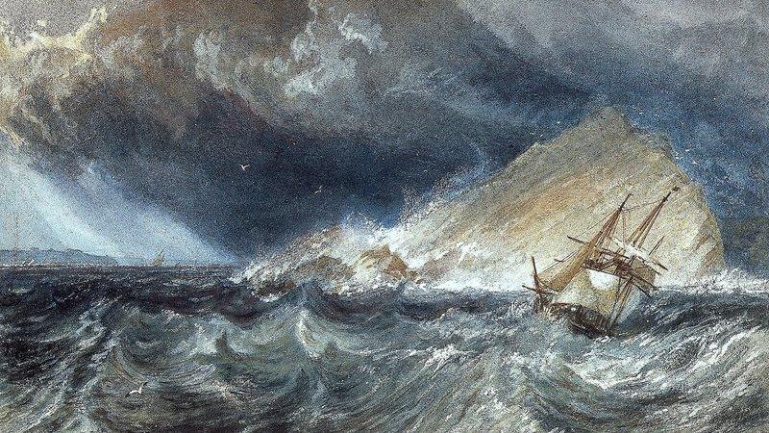
Plan S – FAQ’s
J.M.W. Turner
Stefano Bianco, INFN researcher and member of cOAlition S Expert Group
2017 EPR
Notes:
Buongiorno a tutti e ringraziamenti agli organizzatori per l’opportunita’ di questa chiacchierata informale e spero informativa. E’ vero che ci sono progressi nell’Open Access, ma come il vascello in vista del porto di Plymouth incombe uno scoglio e il periglio non e’ ancora evitato.

Slide 2
Plan S in the National Institute for Nuclear Physics
S.Bianco R.Barbera M.Maggi
D.Menasce L.Patrizii
A.Masiero (eo)
INFN Open Access Working Group
P.Lubrano
INFN Research Assessment Working Group
info: stefano.bianco@lnf.infn.it
oa@lists.infn.it

Slide 3
Open Access
All results from publicly funded research must be immediately and freely available to the taxpayer that has funded it.

Slide 4
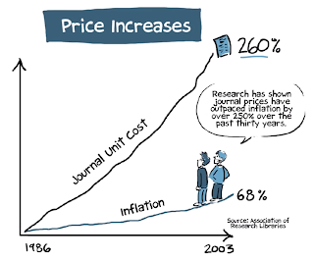
Notes:
quale e’ la crisi che ha portato al movimento Open Access ? Questione di soldi. Non ci possiamo piu’ permettere l’acquisto delle riviste scientifiche, e dipendiamo dagli stessi editori oligopolisti per valutare la nostra stessa ricerca

Slide 5
Top 5 commercial publishers
Large Revenues
No royalties paid to authors
No compensation to peer reviewers
Low cost of editing / formatting

Slide 6
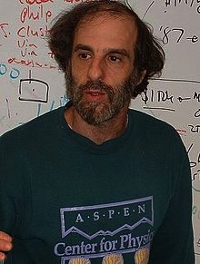
1991 Paul Ginsparg e arXiv
Notes:
paul ginsparg realizzo arXiv per la diffusione dei preprint

Slide 7
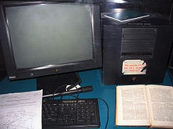
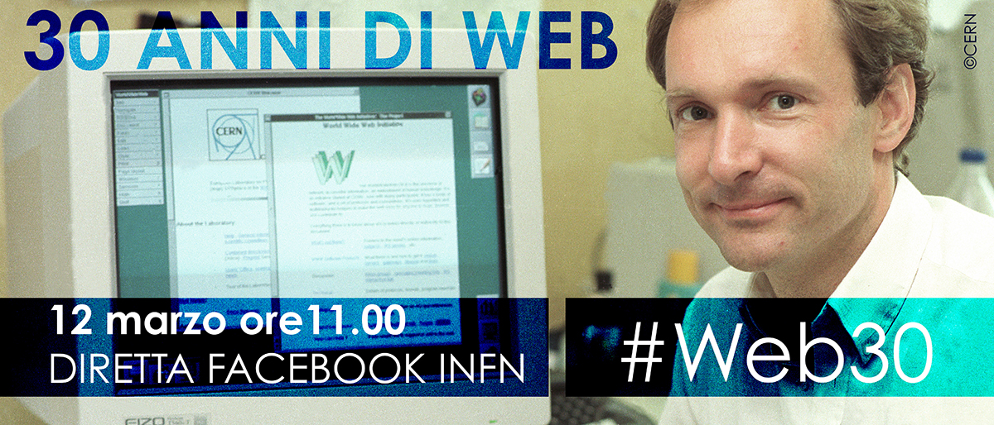
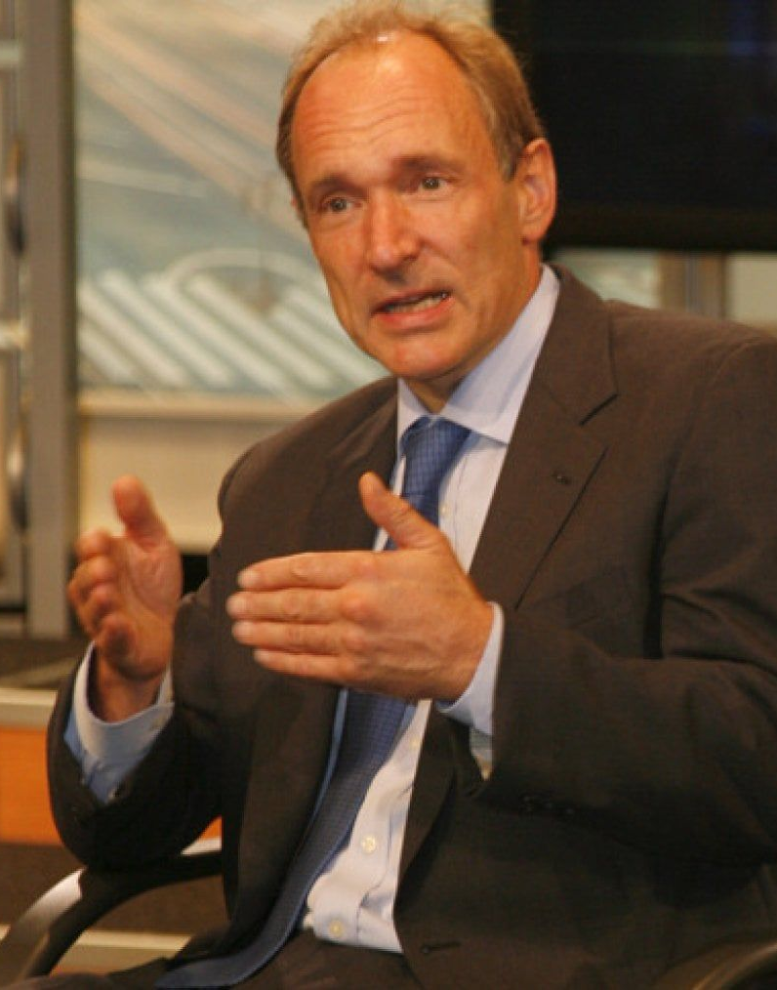
6 agosto 1991 –nascita di www al CERN
Notes:
e quasi contemporaneamente tim berners lee al cern rilascia il prototipo di www

Slide 8
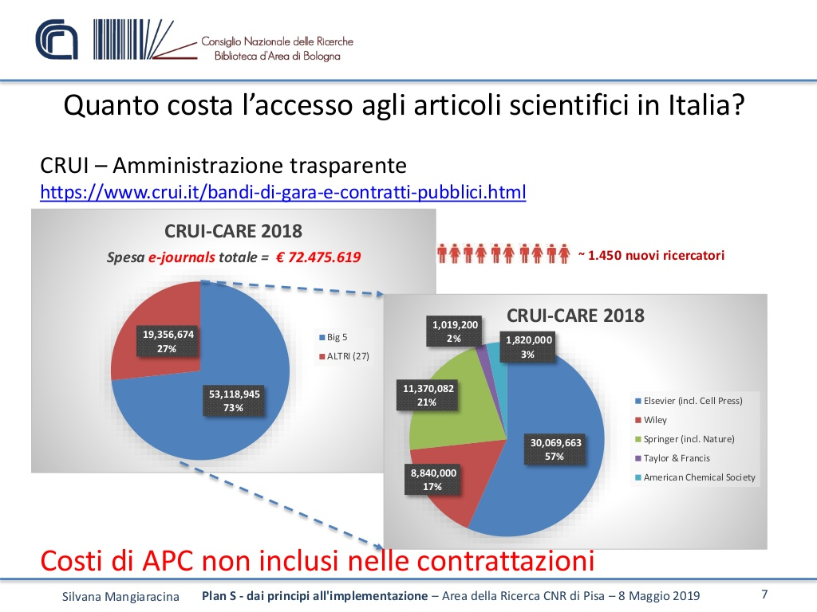
subscriptions in 1 year = 1450 new researchers
Ref:S.Mangiaracina
10.5281/zenodo.1247497

Slide 9
Green Open Access
“Subscription” MODEL
  Publish preprint to OA repository
  Submit to subscription journal, get it accepted
  Wait 0/6/12 months before submitting post-peer review version “postprint/AAM” to OA repository
  Pay Article Processing Costs (APC) and publish OA
  Buy subscription…
  …and also pay APC
Gold Open Access
“Article Processing Costs” MODEL
Hybrid with Double Dipping
Notes:
qualche parola sul gergo usato

Slide 10
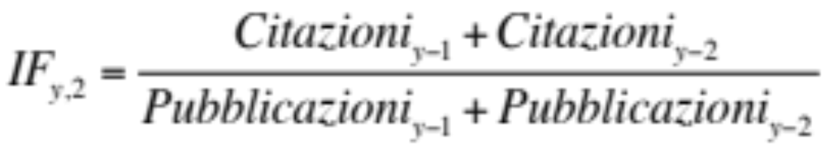
Impact Factor
New journal has IF=0 for two years
IF Index is subject to problems (self citations, negative citations etc.)
Notes:
e’ il momento quindi di introdurre la bibliometria, fonte di parecchi mali. Indici creati con buone intezioni, ma poi messi a punto in maniera spesso surrettizia per millantare autorevolezza
l’IF ad esempio e’ zero per ogni nuova rivvitsa che volesse entrare nel mercato, cosa che rende il dominio degli oligopolisti nmolto difficile da scalfire. e’ numero adatto inoltre ad essere manipolato con una serie di tecnihe.
per la valutazione del singolo venne proposto invece l’h factor che viebe definito qui e vengono dati esempi di fisici famosi e meno famosi

Slide 11

Rsearch assessment, TODAY
Research assessment based on IF_{y,5} and Citations
Authors publish on journals with high IF
Peer review provided by (unpaid) scientists
ANVUR (Research assessment govern. agency) considers only journals indexed on WOS and SCOPUS
New, quality journals cannot have an IF before 2/5 years
Restrictive law on copyright will not guarantee free posting of AAM/postprint unless contractual.
Minimal editing is provided by publishers
Notes:
insomma questo e’ il circolo vizioso attuale:

Slide 12
Establishing Open Access practices is a challenge
The evaluation of research (careers, fundings, etc) is entwined with bibliometric criteria, particularly Impact Factor (IF) in STEM disciplines
Commercial databases are used for governmental research assessment

Slide 13
Infn e Open Access
2007 joins SCOAP3
2013 signs MedOAnet position paper in Rome
2014 signs Messina declaration 2.0
2008 signs Berlin declaration
2010 signs Granada declaration
2018 joins Plan-S
2018 joins OA2020

Slide 14
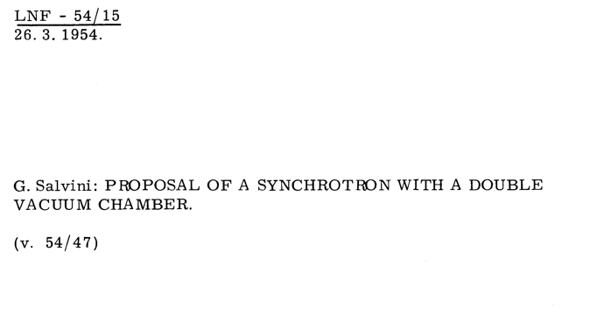
the Frascati institutional repository contains preprints dating back 1954 openaccessrepository.it
Notes:
quindi con tempi molto piu’ ilatati lacomunicazione open access fra fisici ma in generale in tutte le scienze era affidata alla carta e al servizio postale ma funzionava

Slide 15
Settembre 2018
4 Settembre 2018
11 Istituzioni Finanziatrici della Ricerca
lanciano Plan S
Notes:
Il 4 settembre scorso un consorzio internazionale di istituzioni/agenzie finanziatrici della ricerca ha lanciato l’iniziativa Plan S per la pubblicazione Open Access
Il piano S è stato avviato dall'inviato per l'accesso aperto della Commissione europea e ulteriormente sviluppato dal presidente di Science Europe e da un gruppo di capi delle organizzazioni nazionali di finanziamento. Ha inoltre tratto contributi sostanziali dal consiglio scientifico del Consiglio europeo della ricerca.

Slide 17
Plan S Principles (simplified)
We are not going to pay to publish on double dipping journals
We support self archiving and zero-embargo green OA
We are not going to use Impact Factor for evaluation of research
We are going to apply the Plan S principles on new projects starting after January 1st, 2021

Slide 18
May 31st, 2019
Plan S – Implementation Guidance
The Three Roads
Open Access publishing venues (journals or platforms)
Subscription venues
(repository route)
Transition of subscription venues (transformative arrangements)
Authors publish in a subscription journal and make either the final published version (Version of Record (VoR)) or the Author's Accepted Manuscript (AAM) openly available in a repository.
Authors publish Open Access in a subscription journal under a transformative arrangement.
Authors publish in an Open Access journal or on an Open Access platform.
cOAlition S funders will financially support publication fees.
cOAlition S funders will not financially support ‘hybrid’ Open Access publication fees in subscription venues.
cOAlition S funders can contribute financially to Open Access publishing under transformative arrangements.
1
2
3
gold OA
green OA
hybrid in transition
Notes:
So what is the main difficulty in outreaching researchers on plan s ? They do not have time to read. Implementation guidelines ae very clear,plan s is not only gold OA, is not author pays. There are three conformal routes…

Slide 19
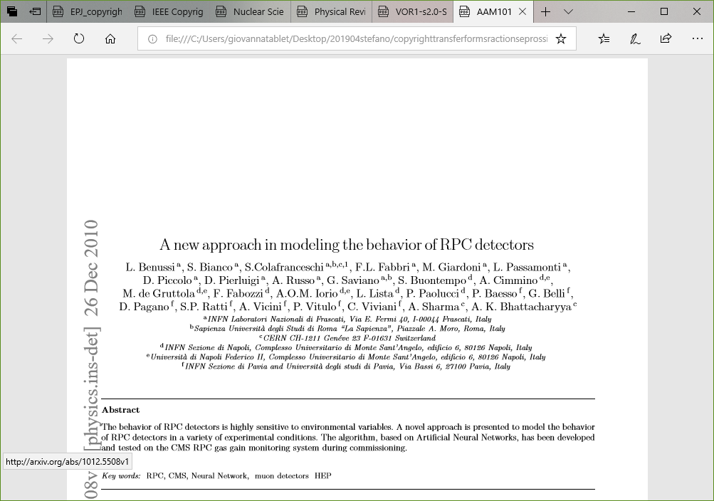
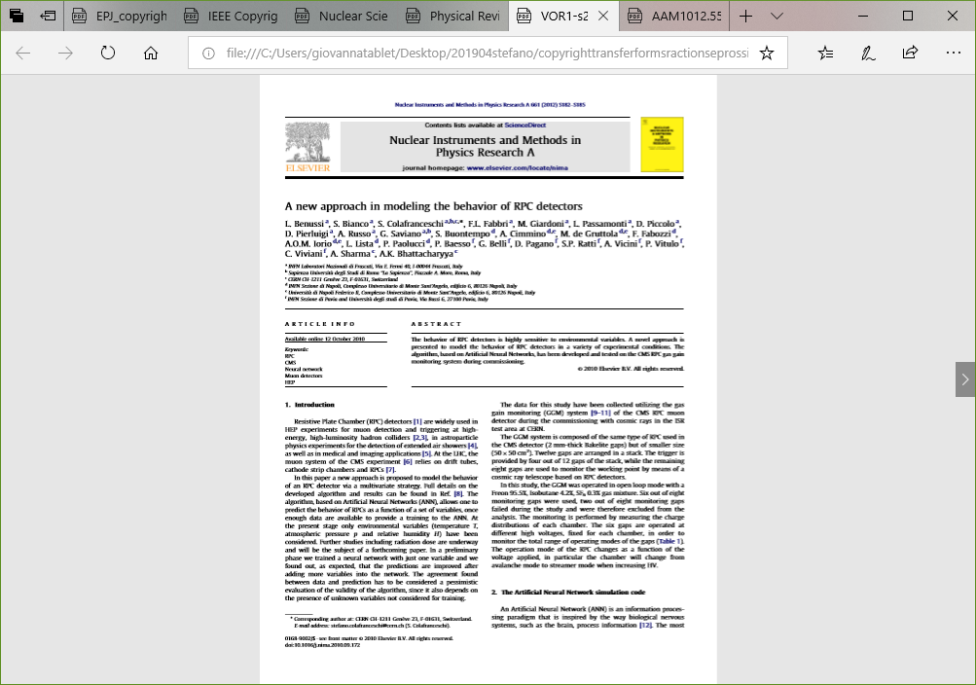
Author’s Accepted Manuscript
Version Of Record

Slide 20
A new Institutional repository
Pilot being discussed for approval in INFN
  openaccessrepository.it
  INVENIO3 + ZENODO
  Open data-ready
  In collaboration with CNR(P.Manghi, D.Castelli et al.)
Try it, free DOI when depositing your content

Slide 21
Openaccessrepository.it
Try it, free DOI when depositing your content

Slide 22
Q:Which model is supported by Plan S ? (Subscriptions/APC/etc)
Plan S does not support any model in particular; funders will not fund publications of papers on double dipping journals.

Slide 23
Q: Is APC publishing the only Plan S - compliant road ?
No. Three conformal roads: 1) gold OA; 2) green OA with zero embargo deposit of AAM; 3) hybrid with transformative agreement

Slide 24
Q: Does Plan S support green OA ? (self-archiving on repositories)
Yes it does, conformity road #2

Slide 25
Q: Does Plan S request authors to pay APC on their research funds ?
No. The author pays model is explicitely condemned. Funders commit to redirect subscription monies without using research monies.

Slide 26
Q: Does Plan S consider no-profit / no-loss scientific societies equal to commercial publishers ?
No. Scientific societies are recognised a special role. Thick report prepared to help ease the process
https://doi.org/10.6084/m9.figshare.c.4561397

Slide 27
In conclusion
Plan S is a disruptive, provocative action aimed to let us emerge from the OA swamp
  SAY NO to any specific economic model, double-dipping, author pays, journal IF
  SAY YES to green road, zero-embargo self-archiving, transformative agreements
New INFN institutional repository in pilot mode free to use
  openaccessrepository.it
Further readings on Plan S:
  S.Bianco, L.Patrizii, Plan S e le società scientifiche – una rivoluzione per l'Open Access? https://doi.org/10.15161/oar.it/23538

Slide 28
Spare slides

