Slide 1


Spotlight on iPSC Reprogramming
Creative Bioarray

Slide 2
CONTENTS
PART ONE
Why iPSCs?
PART TWO
Access to iPSCs
PART THREE
Pluripotency validation

Slide 3
1
PART ONE
Why iPSCs?

Slide 4

iPSC vs ESC
iPSCs are similar to ESCs in morphology, proliferation and the ability to differentiate into all tissue types of the body.
Human iPSCs have a distinct advantage over ESCs as they exhibit key properties of ESCs without the ethical dilemma of embryo destruction.
The generation of patient-specific iPSCs circumvents the roadblock to personalized regenerative medicine therapies by eliminating the potential for immune rejection of non-autologous transplanted cells.

Slide 5
Uses of iPSC in biomedical research
One
Two
Three
Basic research
Applied research
Translational research
Basic research into pluripotency and differentiation.
Applied research into disease specific model systems.
Translational research uses in regenerative medicine.

Slide 6
2
PART TWO
Access to iPSCs

Slide 7

Choice of reprogramming factors
Yamanaka Factors
Thomson Factors
Oct4, Sox2, KLF4, c-MYC
Oct4, Sox2, Nanog, Lin28

Slide 8
Delivery methods for iPSCs derivation
 | Vector type | Cell types | Efficiency
Integrating | Retroviral | Fibroblasts, neural stem cells, liver cells, lerarinocytes, amniotic cells, blood cells, adipose cells | 0.01-0.5%
 | Lentiviral | Fibroblasts, keratinocytes | 0.1-1%
 | Inducible lentiviral | Fibroblasts, Bata-cells，keratinocytes, blood cells, melanocytes | 0.1-1%
Excisable | Transposon | Fibroblasts | 0.1%
 | Floxed lentiviral | Fibroblasts | 0.1-1%
Nonintegrating | Adenoviral | Fibroblasts, liver cells | 0.001%
 | Plasmid | Fibroblasts | 0.001%
DNA-free | Protein | Fibroblasts | 0.001%
 | RNA | Fibroblasts | 1%

Slide 9
Method | Pros | Cons
Retro- and Lentivirus | Good efficiency, easy to implement, validated for multiple cell types | Even with excisable vector there is a small footprint retained in reprogrammed cells
Lentiviral (miRNA) | Very high efficiency | Transgene integration leaves footprint and validated for only one cell type
miRNA (direct transfection) | Zero footprint | Low efficiency, and validated for only one cell type
Adenoviral | Zero footprint | Low efficiency, validated for only one cell type, and technically challenging
Sendai virus | Zero footprint, Good efficiency, validated for multiple cell types, and reprogramming factor viral extracts available commercially | Cost if purchased commercially, if virus is generated by researcher the method is technically challenging, and licensing/patent issues may exist
mRNA | Zero footprint, high efficiency, and mRNAs for reprogramming factors available commercially | Cost if purchased commercially, technically challenging if mRNA generated by researcher, labor intensive, and published work only on fibroblasts
Protein | Zero footprint | Low efficiency, technically challenging, long time to reprogram, and published work only on fibroblasts
Episomal | Zero footprint, good efficiency for most cell types, and validated for multiple cell types | Some cell types (fibroblasts) reprogram with low efficiency
PiggyBac | Zero footprint and good efficiency | Published work on only on fibroblasts, no published data demonstrating excision of transposon from human iPSCs, and licensing/patent issues may exist
Minicircles | Zero footprint | Low efficiency and validated for only one cell type
Pros and Cons of various delivery methods

Slide 10
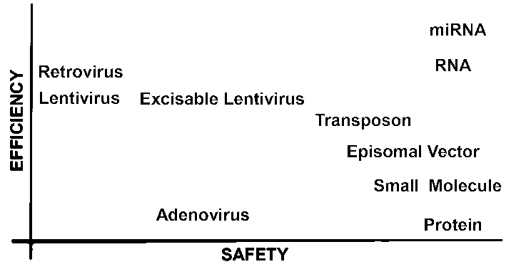
Comparison of efficiency, integration and ease-of-use
Although there is no universal method that can handle every situation at least one of the methods described in this chapter should be able to cover nearly every need for a researcher attempting to produce iPSCs.
 | Lentivirus/retrovirus | Adenovirus | Episomal/Minicircle | Protein | Modified mRNAs
Efficiency | 0.001-0.01% | 0.0001% | 0.0001% | 0.00001% | >1%
Integration | Yes | No (DNA) | No (DNA) | No | No
Multiple transductions | No | No | No/Yes | Yes | Yes

Slide 11
3
PART THREE
Pluripotency validation

Slide 12
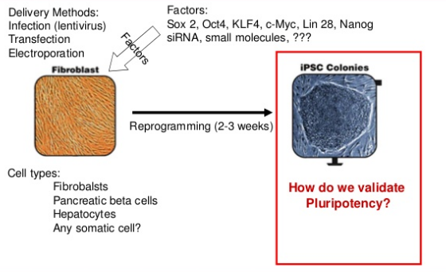
Pluripotency validation

Slide 13
Pluripotency validation
Assay | Advantages | Disadvantages
In vitro differentiation | Controlled differentiation into cell type of interest | Differentiation protocols and functional assays for only few cell types available
Teratoma formation | Gives information about spontaneous differentiation potential into three germlayers; assay with highest stringency for human cells | Not quantitative; cannot detect abnormal cells
Chimera development | Tests potential to contribute to normal development and adult tissues upon blastocyst injection | Subtle abnormalities may be masked and complemented by host blastocyst-derived cells
Germline transmission | iPSC-derived offspring document potential to form functional germ cells, indicating genomic integrity | Readout for single, very specialized, nonessential cell type
Tetraploid complementation | Measures potential to direct normal development of an entire mouse, including all cell types | Subtle developmental or postnatal phenotypes may be missed; does not assess the capacity of cells to form extraembryonic tissues

Slide 14
Pluripotency validation
Assay | Advantages | Disadvantages
Morphology | Rapid and simple | Not specific to pluripotent cells
Alkaline phosphatase staining | Straightforward colorimetric assay | Not specific to pluripotent cells
Pluripotency markers | Detection of endogenous pluripotency genes using immunofluorescence, PCR, or reporter alleles | Some genes also activated in partially reprogrammed cells (e.g., Fbxo15)
Retroviral silencing | Hallmark of pluripotent state; used as surrogate for global epigenetic reprogramming | Requires delivery of factors by retroviral vectors or addition of ‘‘indicator’’ viral vector; nonspecific
DNA demethylation | Promoter demethylation of pluripotency genes (e.g., Oct4) is good indicator for epigenetic remodeling) | Some somatic cells show demethylation of pluripotency genes (e.g., Nanog in melanocytes)
Factor independence | Self-renewal in the absence of dox-inducible transgenes is good indicator of faithful reprogramming | Requires use of inducible transgenes

Slide 15

Pluripotency validation
All morphological attributes
One
Expression of key pluripotency genes
Two
Transgene independence
Three
Proof of functional differentiation.
Four

Slide 16

Prospects and challenges
Although many stem cell researchers dream of iPSCs being used to treat disease directly, the clinical utility of iPSCs, for the moment, is not as exciting as their role in research and their usefulness in modeling disease.
iPSCs have given us the ability to look at disease in a very meaningful way, in large part because we can study the disease on an individual level, in the context of the patient's unique genetic makeup. This personalized look at disease is incredibly powerful and will certainly inform the development of new and exciting treatments in the future.

Slide 17
www.creative-bioarray.com

