Slide 1
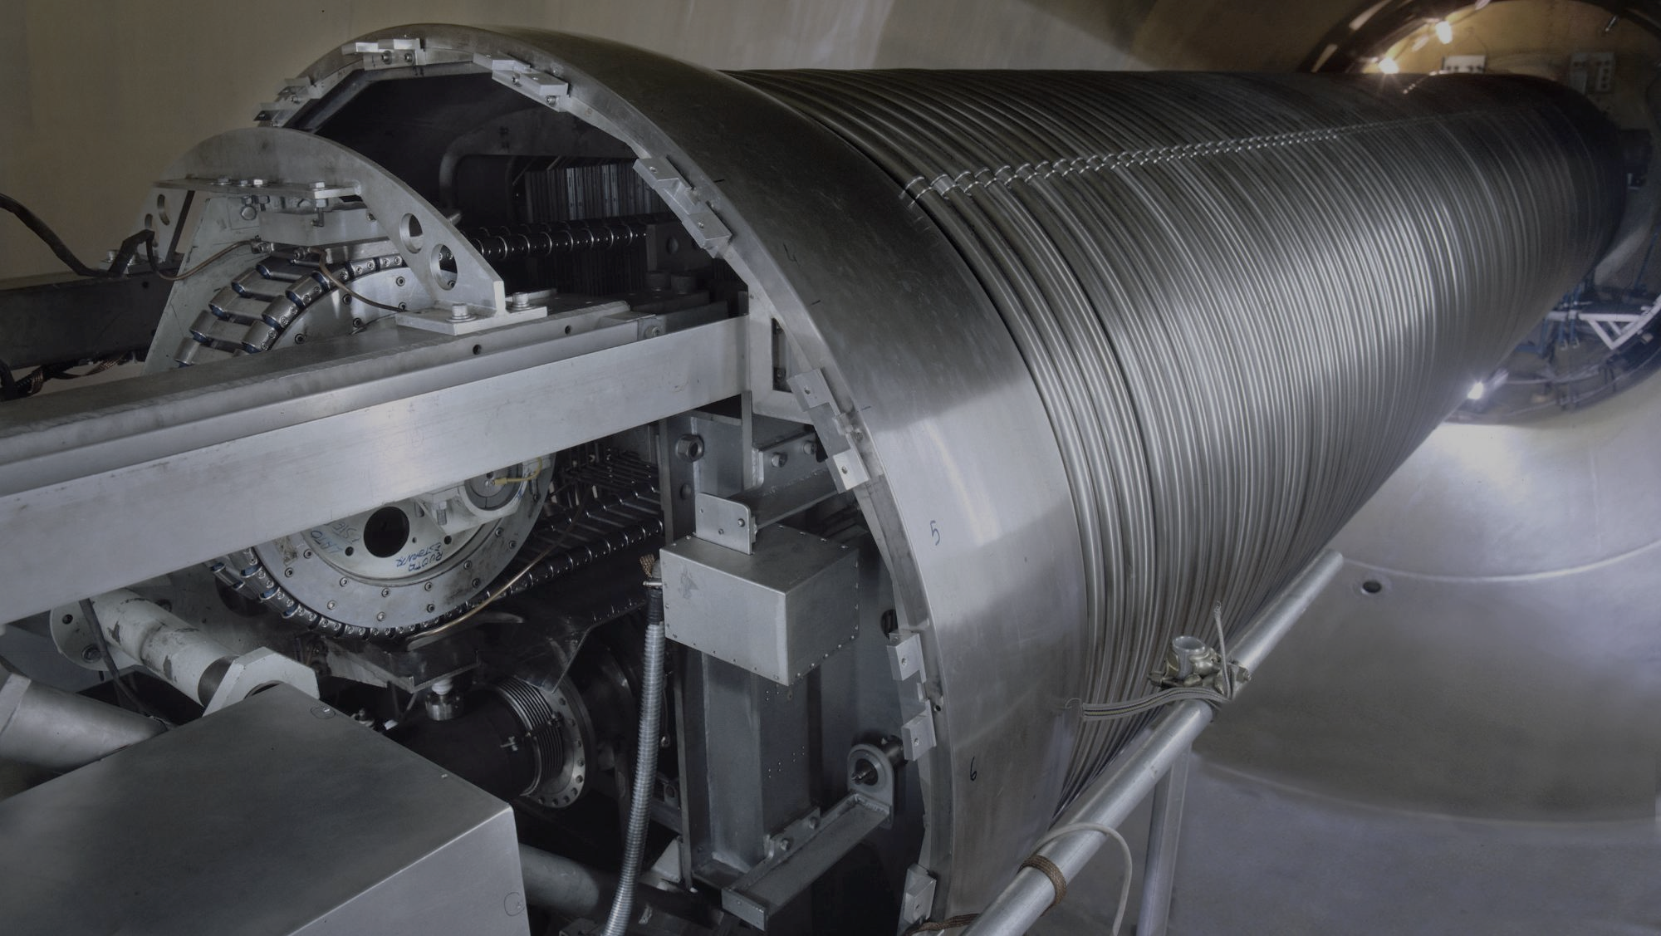
INFN’s Technology Transfer in Particle Accelerators sector

Slide 2
Some figures…
Elettra’s accelerators consume 32 GWh of electric energy per year from the national grid and its two high-efficiency trigeneration plants consume 5.5 million Smc of gas per year to provide uninterruptible electric power, heating and cooling. Due to increased energy prices, in second half of 2024, Elettra reduced beam time to 50% [6]
In 2023, overall electricity consumption of LNL was 16.7 GWh [9]
SESAME is the first synchrotron light facility in the region and the world’s first large accelerator complex to be fully powered by renewable energy. Electricity for its operations is supplied by an on-grid photovoltaic system having a total power capacity of 6.48 MW [7]
HZB in Berlin, Germany, that operates the BESSY II synchrotron secured their full electricity needs with renewable energy, saving up to 17,400 tonnes of CO₂ per year [8]

Slide 3
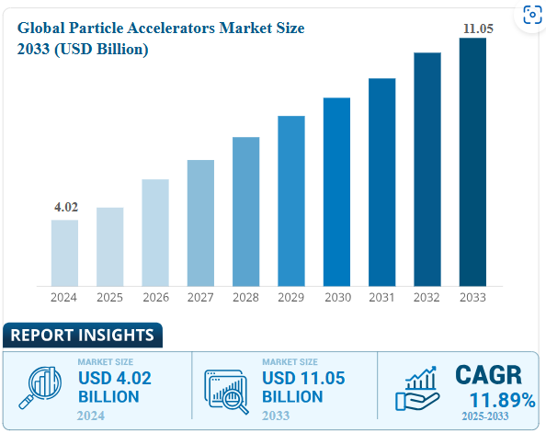
50000+ Accelerators worldwide, 11B$ projected market size
Business Research Insights [1]
S. Sheehy, Application of Particle Accelerators [2]

Slide 4
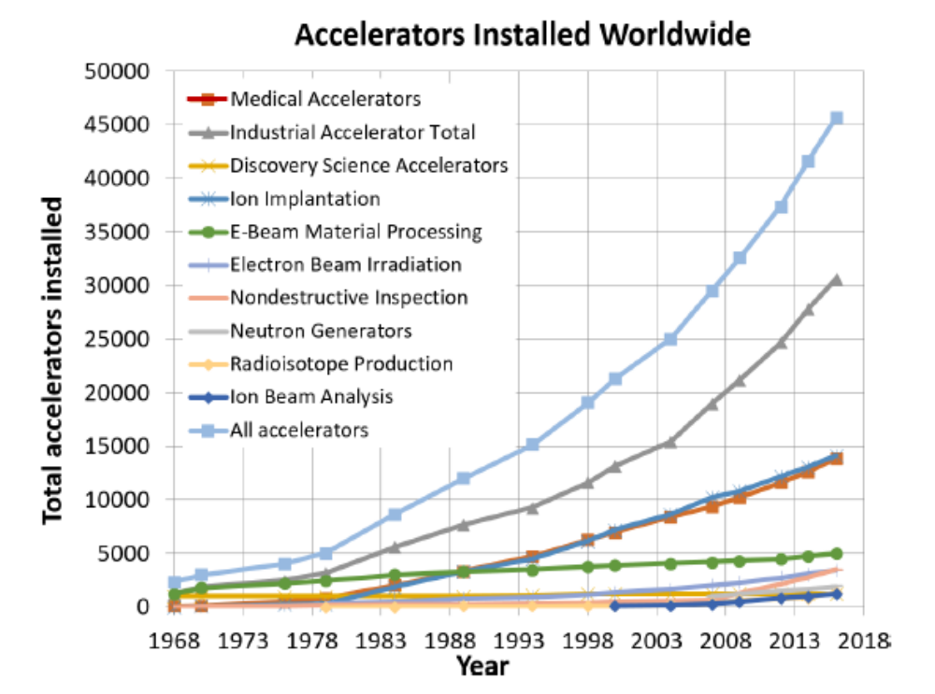
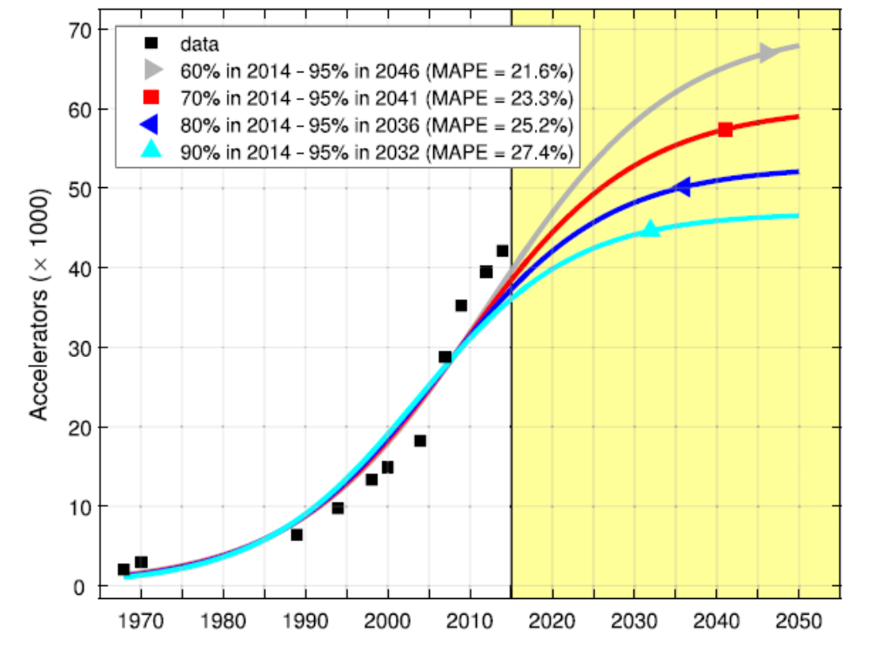
Is this growth sustainable?
Doyle et al. The Future of Industrial Accelerators and Applications [4]
Florio et al. The socio-economic impact of a breakthrough in the particle accelerators’ technology: A research agenda [5]

Slide 5
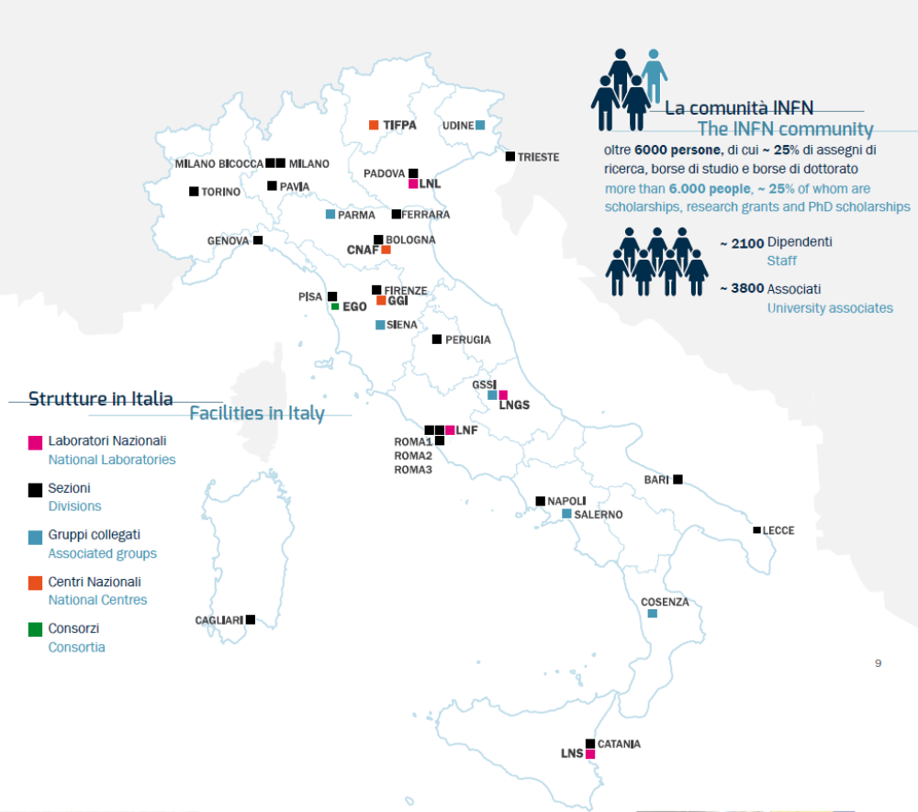
Spread on the territory
20 Divisions
4 National Labs
3 National Centers

Slide 6







2015 – 2024: spotlight on TT
292
Patents filed
52
Licences
31
PoC projects funded
6
Spin-offs
619
Agreement Signed
403
Partners

Slide 7
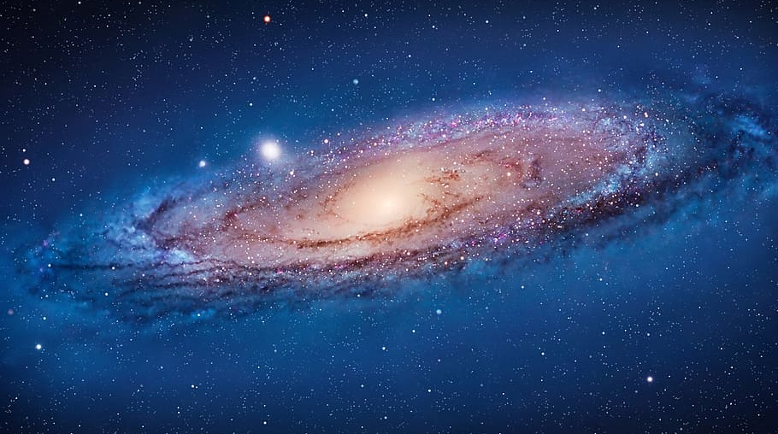
INFN’s technology galaxy
Surface treatments
Accelerators for cultural heritage
Vacuum and cryogenics
Detectors
New acceleration technologies
Material science
Accelerators for life science
Construction techniques

Slide 8
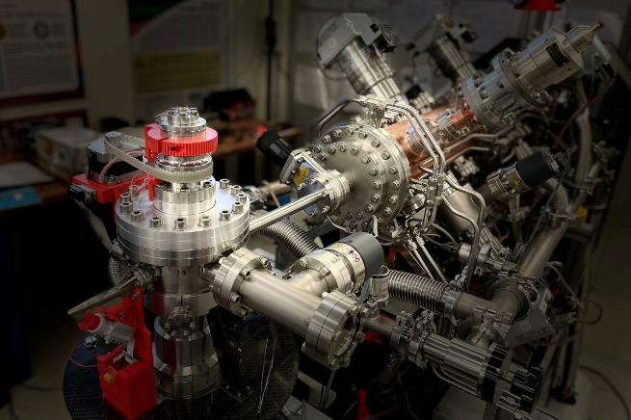
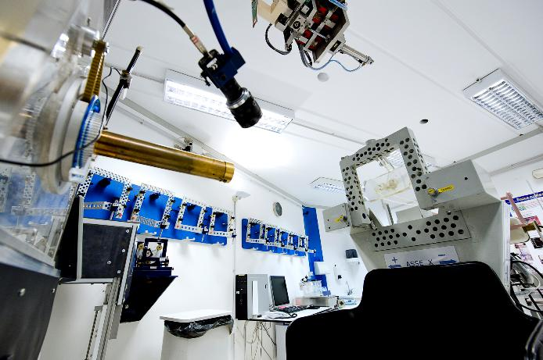
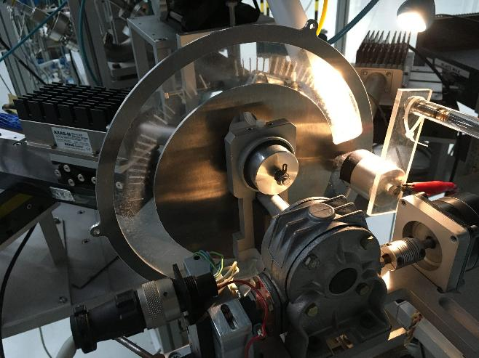

From basic science to…
Cultural heritage
Hadron therapy
Industry
Environmental analysis

Slide 9
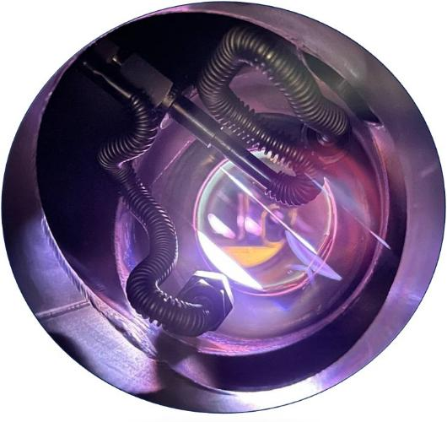
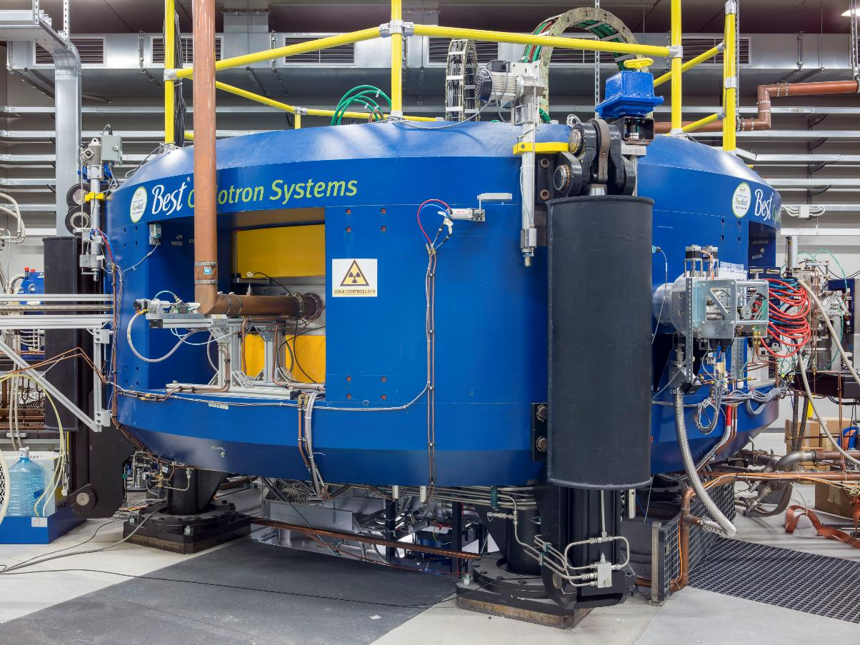
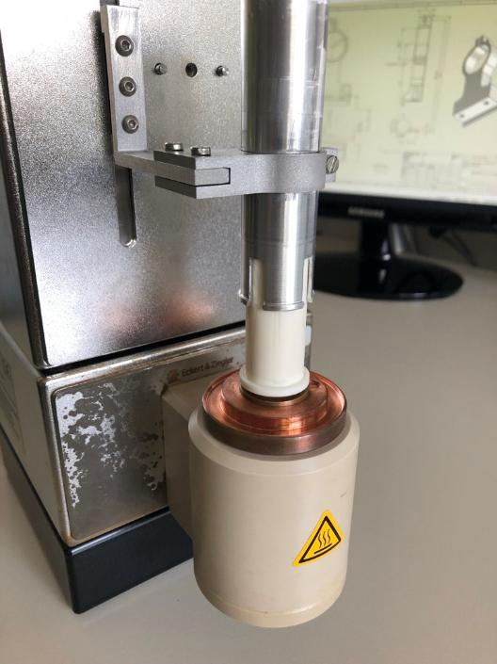
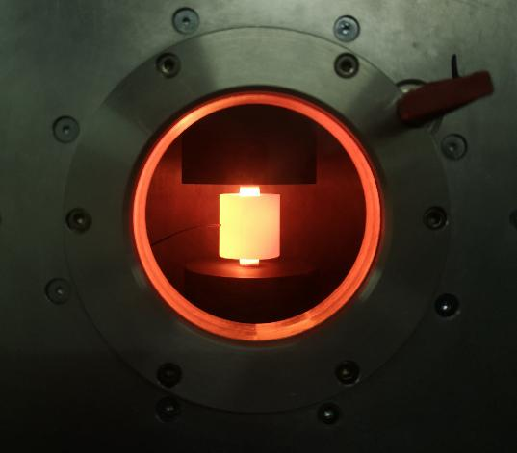
From beam production to…
Target production
Dissolution system
Sintering technology

Slide 10
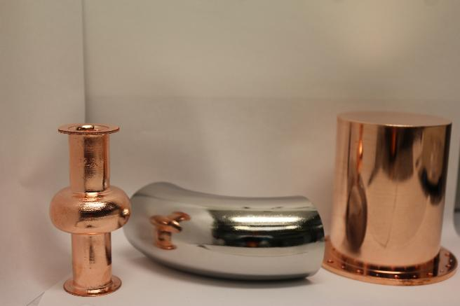
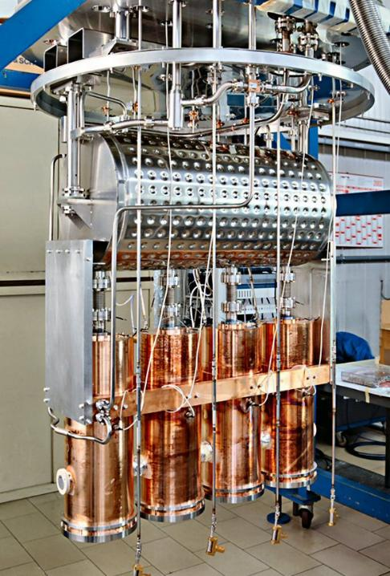
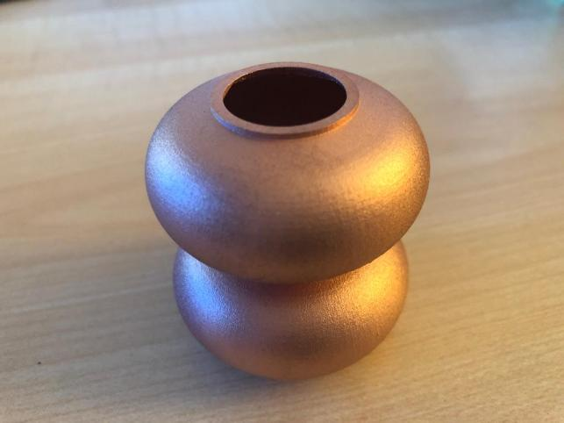
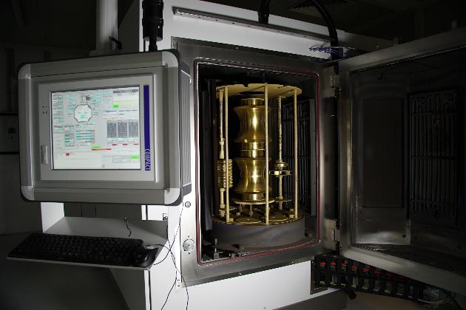
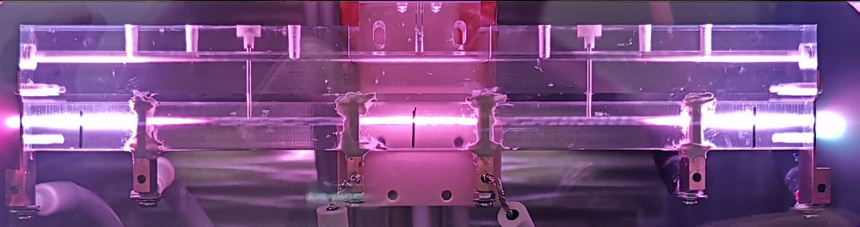
From accelerator development to…
Plasma electropolishing
Additive manufacturing
Coating systems
New acceleration technologies

Slide 11
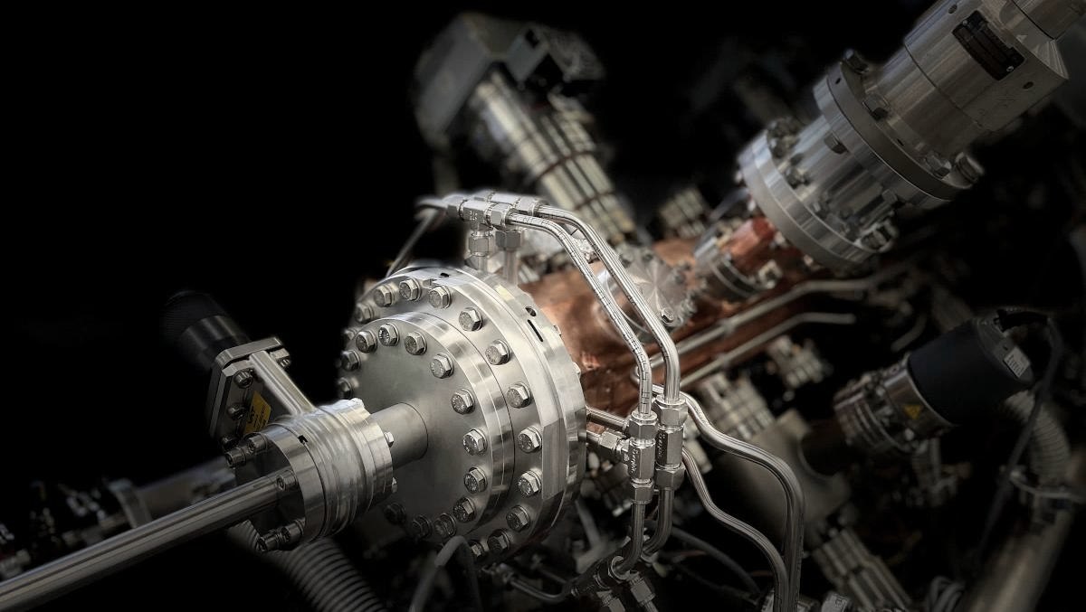
technology provider
INFN is not only a technology purchaser but also a

Slide 12










Why a TT Office is needed?
https://istnazfisnucl.sharepoint.com/sites/TrasferimentoTecnologico/SitePages/Formazione-in-Pillole-di-TT.aspx
Notes:
Ecco quindi che chi si occupa di trasferimento tecnologico si trova a fare da «mediatore culturale» tra il mondo della ricerca e quello produttivo, che comprende on solo gli industriali, ma anche i tecnici che lavorano nelle industrie, i mandatari brevettuali, gli enti che erogano finanziamenti, ecc.
Con in più il vincolo di dover rispettare le regole e le procedure della pubblica amministrazione che, spesso e volentieri sono oscure sia alla comunità scientifica che a quella industriale. E molte volte anche a chi ci lavora dentro.

Slide 13
Thank you! (tto@lists.infn.it)
Ilaria Giammarioli
(Office Manager)
Stefania Lucantonio
Pier Paolo Deminicis
Diego Tonini
Simona Mancuso
Cristina Placido

Slide 14
Bibliography
https://www.businessresearchinsights.com/market-reports/particle-accelerators-market-108667
S. Sheehy, Application of Particle Accelerators, arXiv:2407.10216v1 [physics.acc-ph] 14 Jul 2024
Accelerator-based BNCT projects, https://isnct.net/bnct-boron-neutron-capture-therapy/accelerator-based-bnct-projects-2021/
Doyle et al. The Future of Industrial Accelerators and Applications, Reviews of Accelerator Science and Technology Vol. 10, No. 01, pp. 93-116 (2019) https://doi.org/10.1142/S1793626819300068
Florio et al. The socio-economic impact of a breakthrough in the particle accelerators’ technology: A research agenda, Nuclear Inst. and Methods in Physics Research, A 909 (2018) 21–26
https://www.elettra.eu/science/top-stories/energy-crisis-impact-on-user-activities-at-elettra-sincrotrone-trieste.html
https://www.sesame.org.jo/news/sesame-becomes-worlds-first-large-accelerator-complex-be-fully-powered-renewable-energy
Strive towards sustainability. Nat. Phys. 19, 761 (2023). https://doi.org/10.1038/s41567-023-02117-0
INFN Environmental report https://www.infn.it/wp-content/uploads/2025/01/Environmental_Report_23.pdf

Slide 15
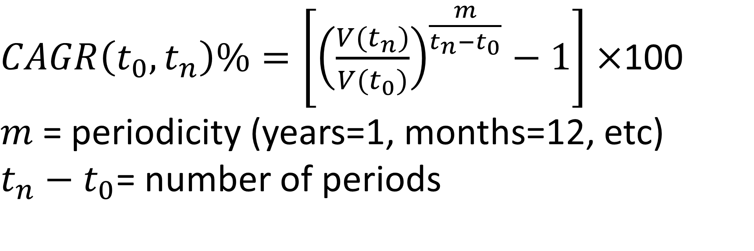
$CAGR\left(t_{0},t_{n}\right)\%=\left[{\left(\frac{V(t_{n})}{V(t_{0})}\right)}^{\frac{m}{t_{n}−t_{0}}}−1\right]×$100
$m$= periodicity (years=1, months=12, etc)
$t_{n}−t_{0}$= number of periods

Slide 16
Distribution by sector and application
Sector | Application | Accelerated particles | Energy (MeV) | N° in the world | Ref.
Medical | Radiotherapy | Electrons → X-Rays | 6-25 | ̴12500 | 2
 | Hadron therapy | Protons, ions (C) | 250 (p), 450/u (C) | ̴100 | 2
 | FLASH therapy | Electrons → X-Rays
 | BNCT | Protons → Neutrons |  | ̴30 | 2,3
 | Radioisotopes | Protons | 7-11 (short life), 70-100 (long life) | ̴1000 | 2,4
Industrial | Ion implantation | Ions | 10⁻⁴-1 | ̴12000 | 2
 | E-beam irradiation | Electrons | 1-10 |  | 2
 | Radiography | Electrons → X-Rays | 1-10 |  | 2
Ion beam analysis | RBS | Proton, He | 1-10 |  | 2
 | PIXE | Proton, He | 1-10 |  | 2
 | AMS | Ions (C) | 1-10 |  | 2
Security | Cargo scanner | Electrons → X-Rays | 1-10 |  | 2
Science | Synchrotron light |  |  |  | 2
 | Spallation neutron | Protons → Neutrons | 1000 |  | 2
 | …

